Slide 1


Slide 2

Digital Marketing
Assignment Report
ASSIGNMENT FOLIO
Assignment Folio of
Digital Marketing
Submitted to
Dezyne École College
Toward Digital Marketing
By
BCA
3rd Semester
Bharat Raj Bagri
Dezyne École College
106/10, Civil Lines, Ajmer
www.dezyneecole.com

Slide 3
Digital Marketing
Acknowledgement
ASSIGNMENT FOLIO
We take this opportunity to express our sincere gratitude to Dezyne École College for providing us with the knowledge, resources, and guidance essential to the successful completion of this project.
Our deepest thanks to our respected Principal, Dr. Vinita Mathur, for her visionary leadership and continuous encouragement. Her commitment to academic excellence and student growth has been a constant source of motivation and pride.
We are equally thankful to all our faculty members for their consistent support, expert advice, and valuable insights that shaped our learning and helped us achieve this milestone.
Lastly, we extend heartfelt thanks to everyone who directly or indirectly contributed to the success of this project.
We are proud to be part of Dezyne École College, an institution that truly nurtures professionalism, innovation, and purpose.
With sincere appreciation,
Bharat Raj Bagri
Department – BCA
Dezyne École College, Ajmer

Slide 4
Digital Marketing
Case Study
--------------------------------------------------------------------------------------------------------------------------------------------------------------------------------
ASSIGNMENT FOLIO
Objective:
Increase Website Traffic, Generate Quality Leads, Improve Brand Visibility, Boost Course Enrolments & Maximise ROI
1. Search Campaign Strategy
Targeted high-intent keywords related to computer courses.
2. Structure Ad Groups
Separate ad groups for each course to improve relevant and Quality Score.
3. Optimized Wix Landing Page
Mobile-friendly design with strong call-to-action buttons.
4. Conversion Tracking Setup
Measure form submission and call clicks for performance analysis.
5. Smart Bidding Strategy
Used “Maximize Conversions” to optimize ad spend automatically.
--------------------------------------------------------------------------------------------------------------------------------------------------------------------------------

Slide 5
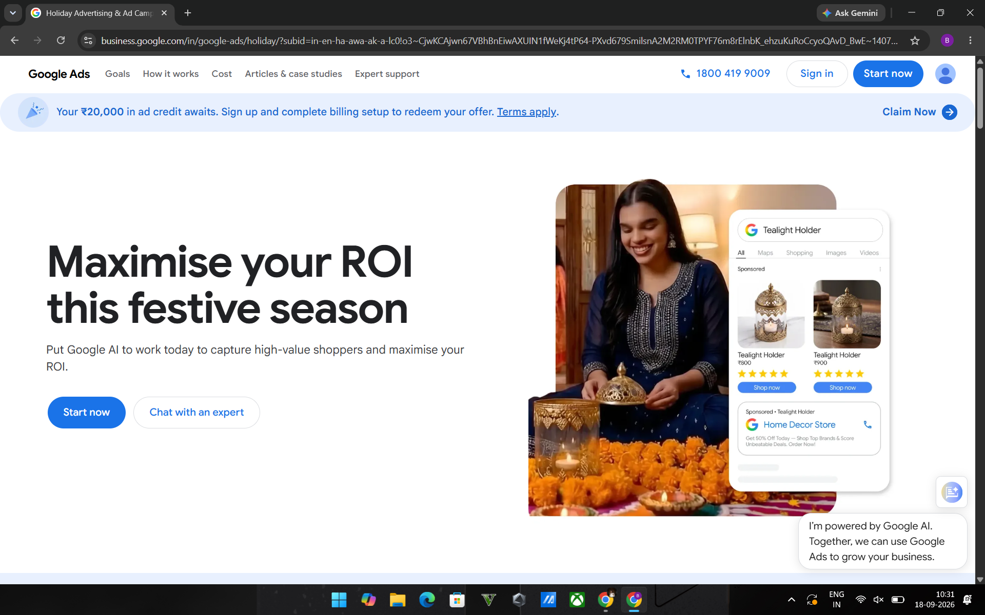
GOOGLE ADS OVERVIEW

Slide 6
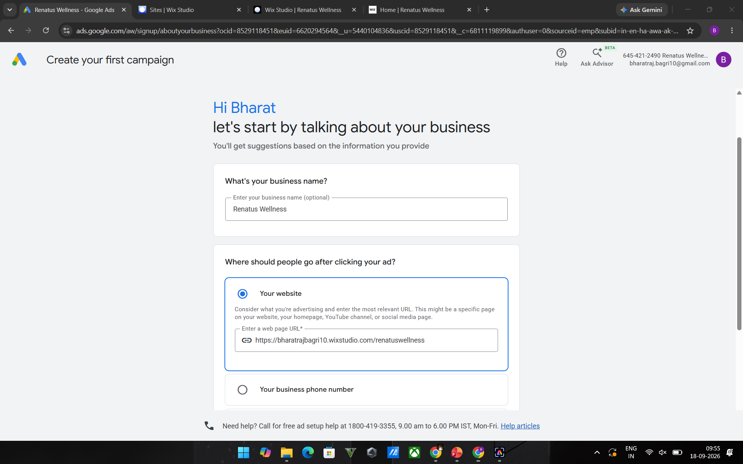
GOOGLE ADS OVERVIEW

Slide 7
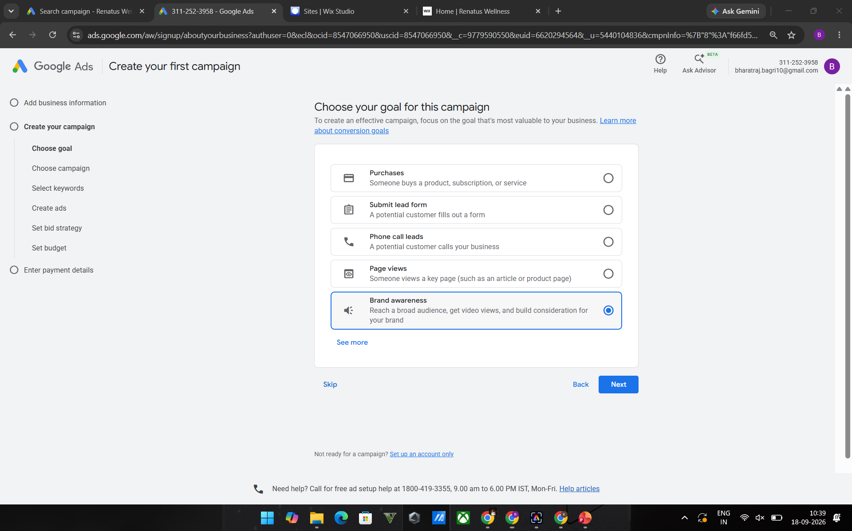
GOOGLE ADS OVERVIEW

Slide 8
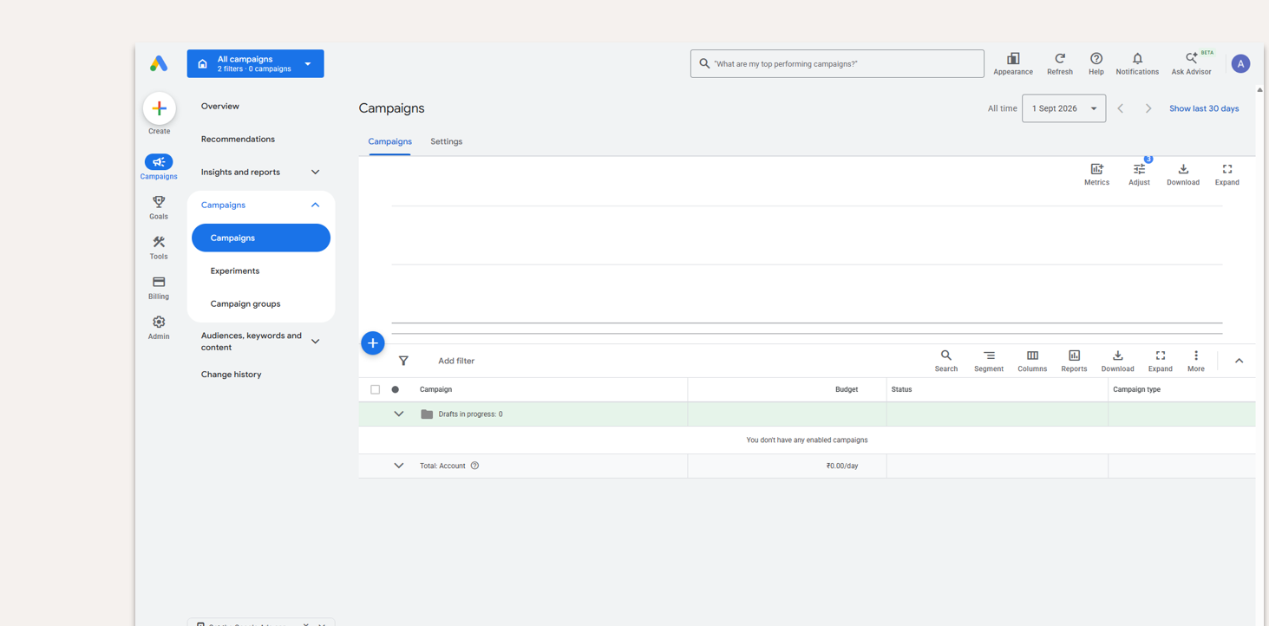
GOOGLE Dashboard

Slide 9
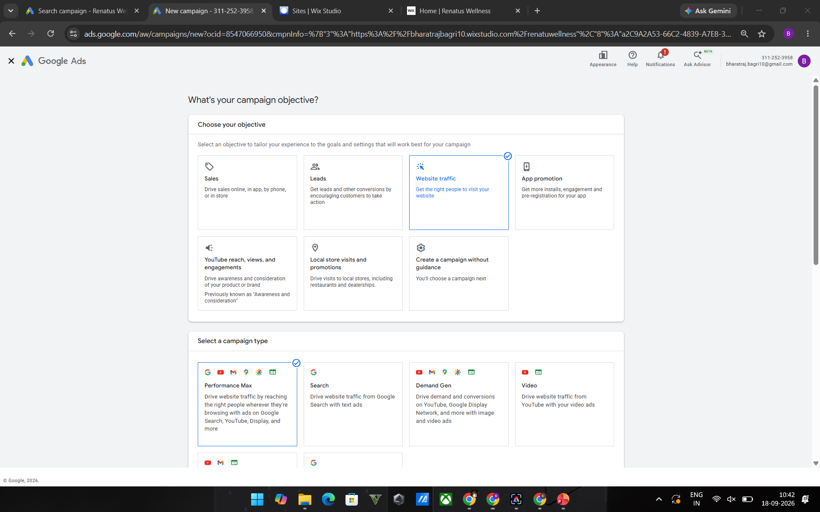
GOOGLE CAMPAIGN OBJECTIVE

Slide 10
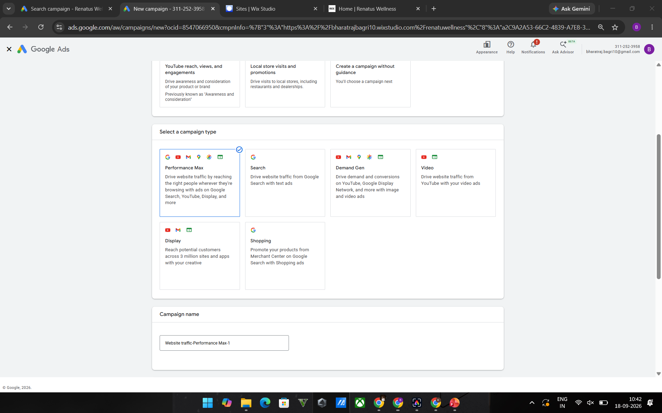
GOOGLE CAMPAIGN OBJECTIVE

Slide 11
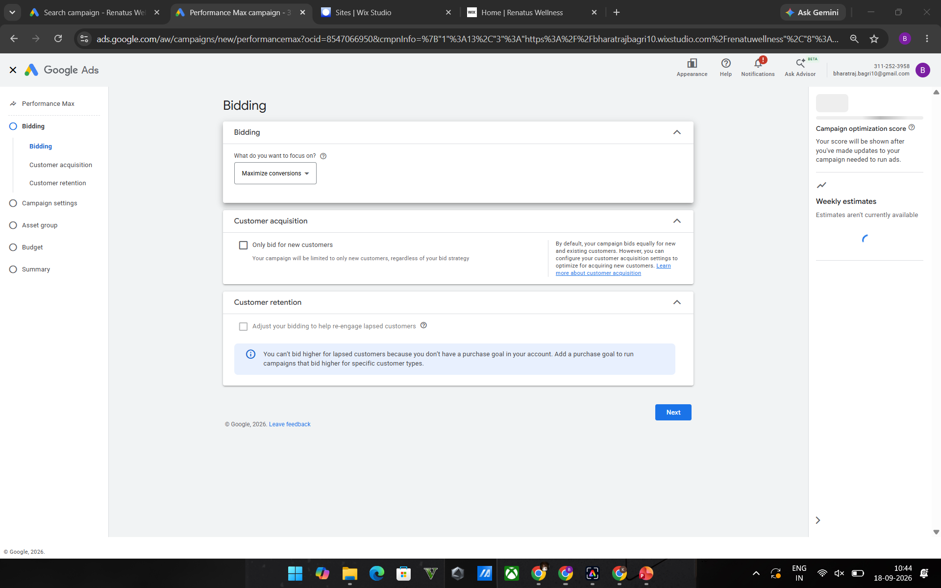
PERFORMANCE MAX ( Bidding)

Slide 12
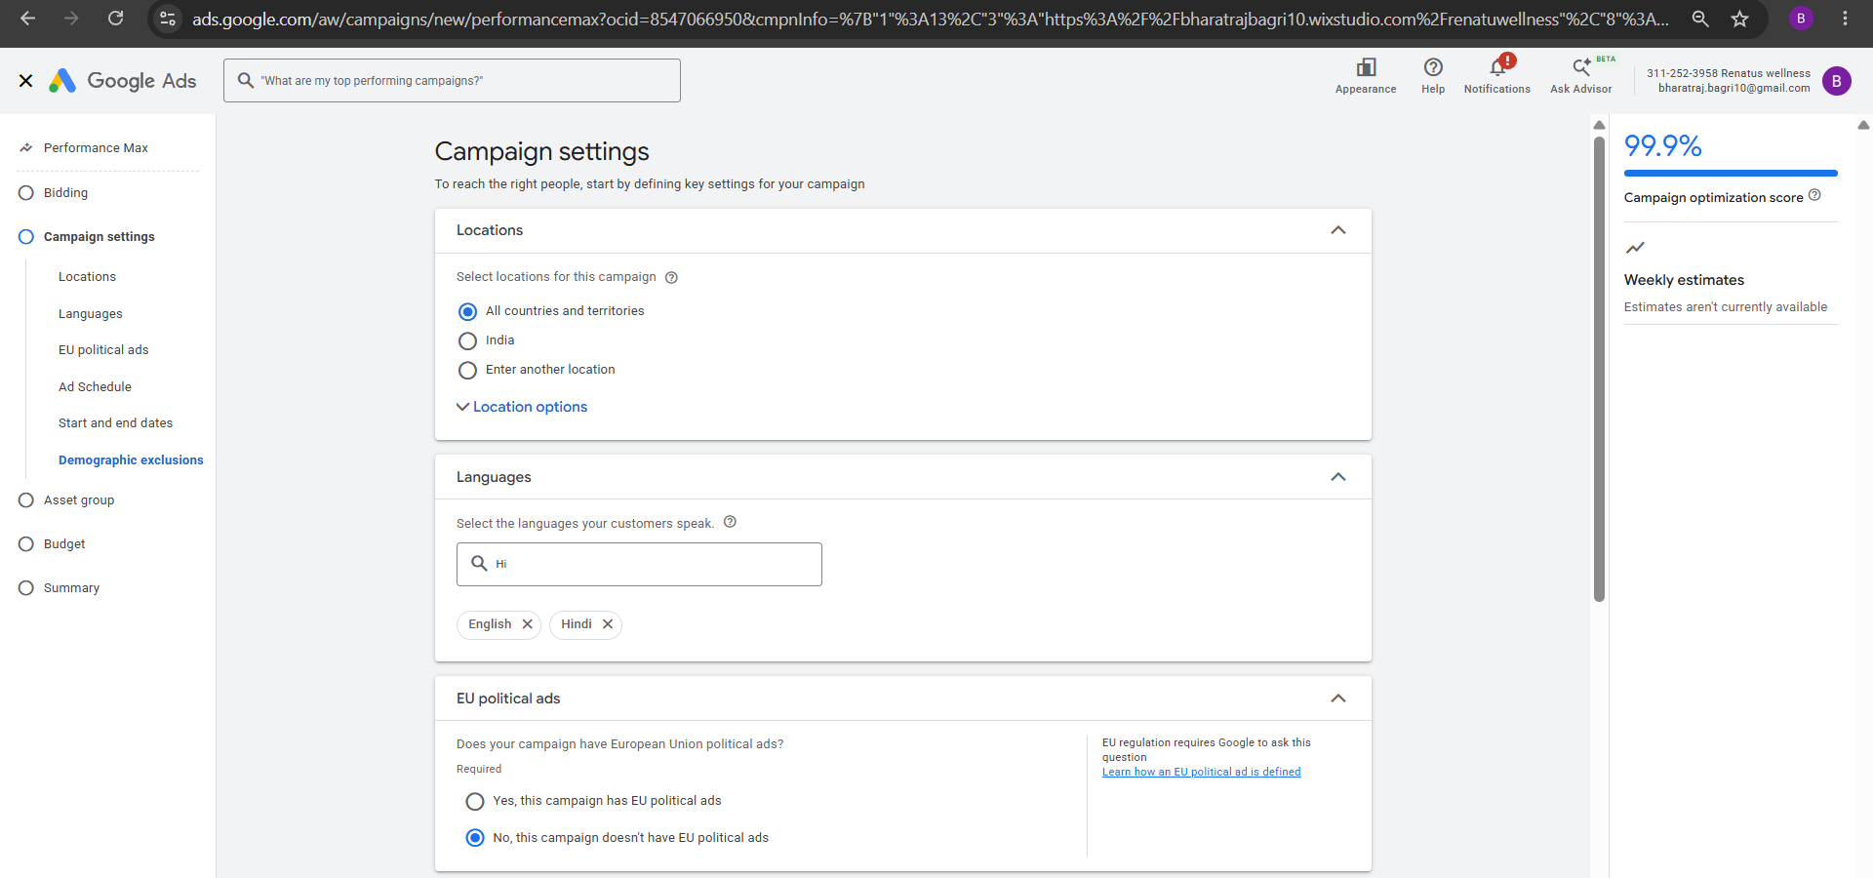
PERFORMANCE MAX ( Campaign)

Slide 13
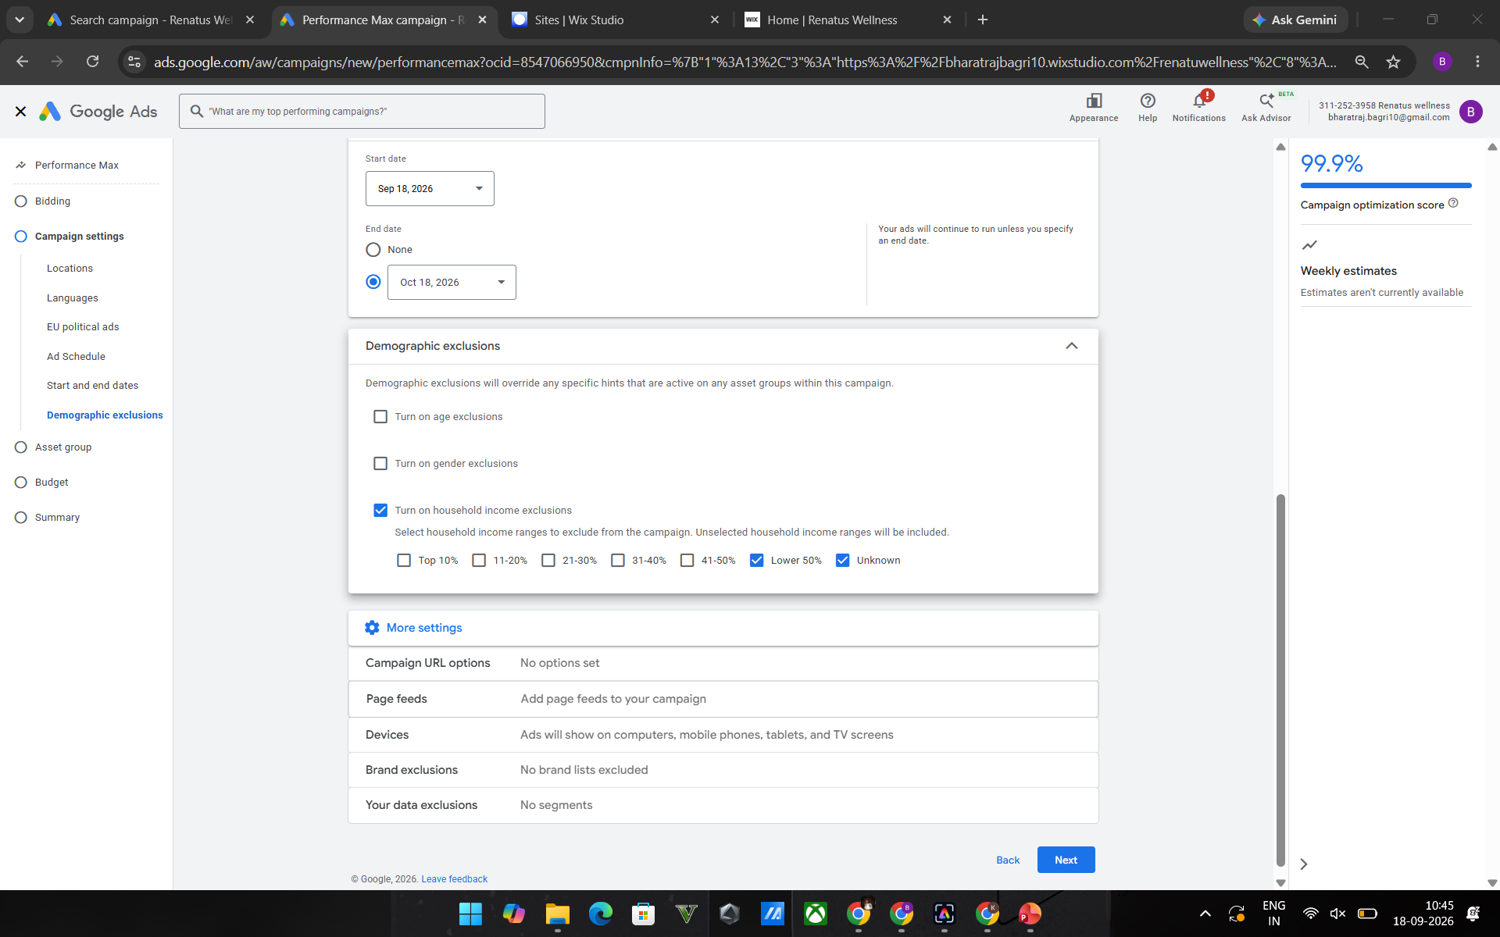
PERFORMANCE MAX ( Campaign)

Slide 14
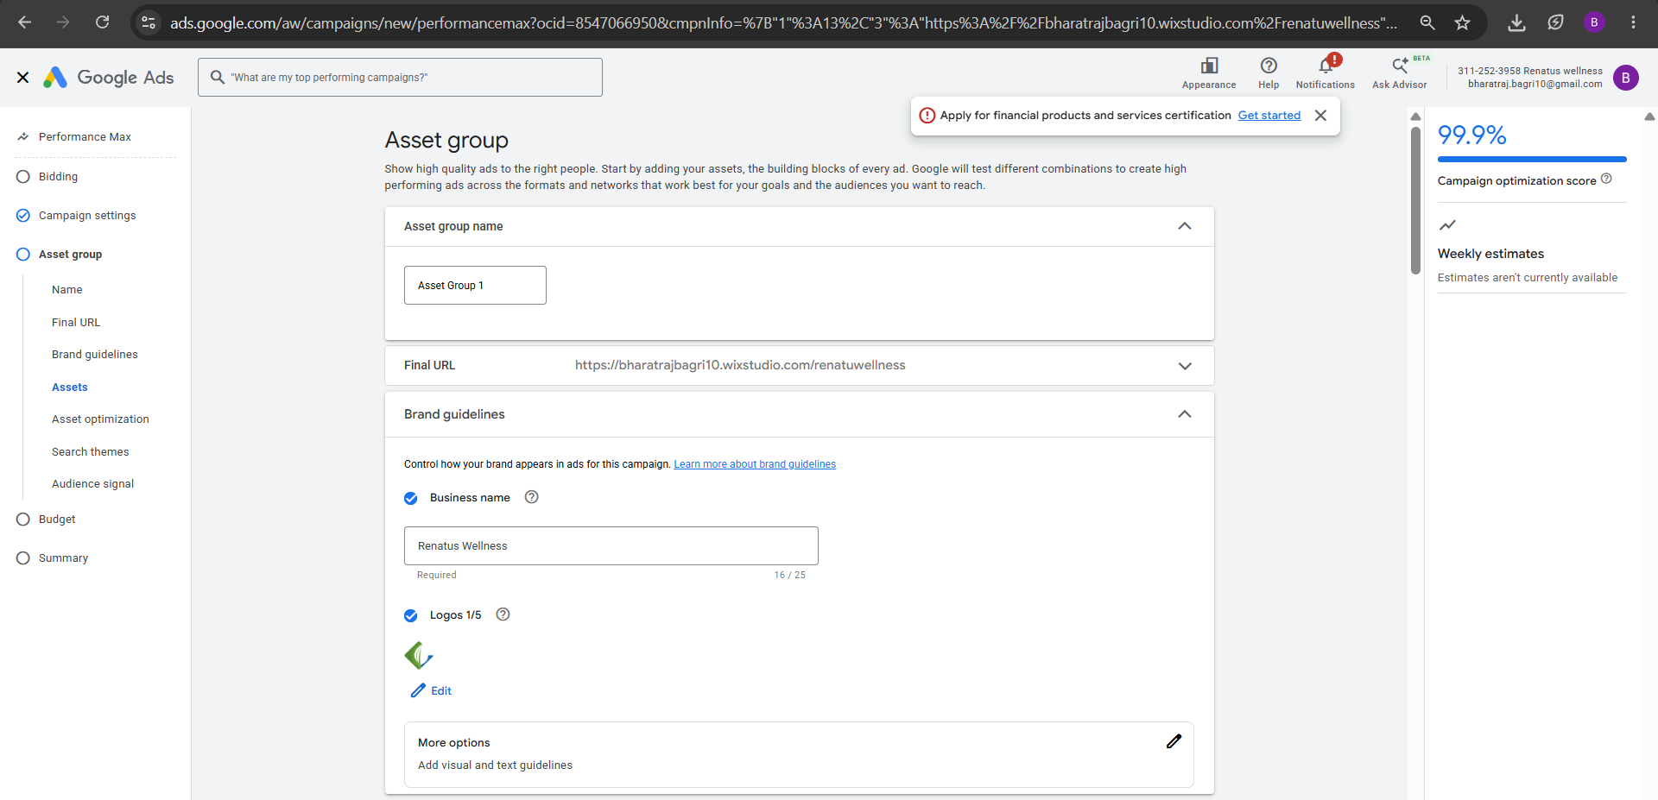
PERFORMANCE MAX ( Asset Group)

Slide 15
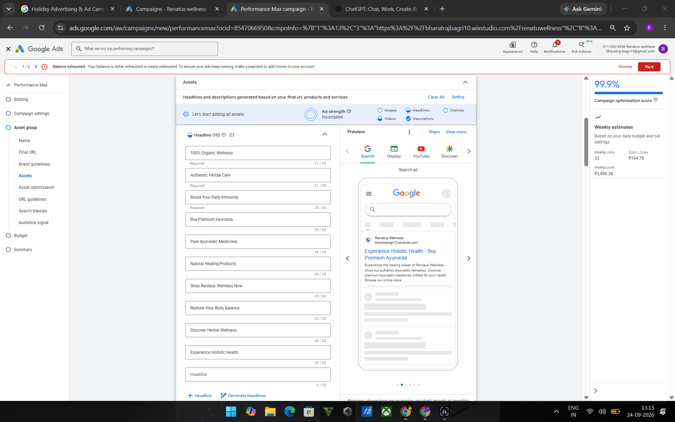
PERFORMANCE MAX ( Asset Group)

Slide 16
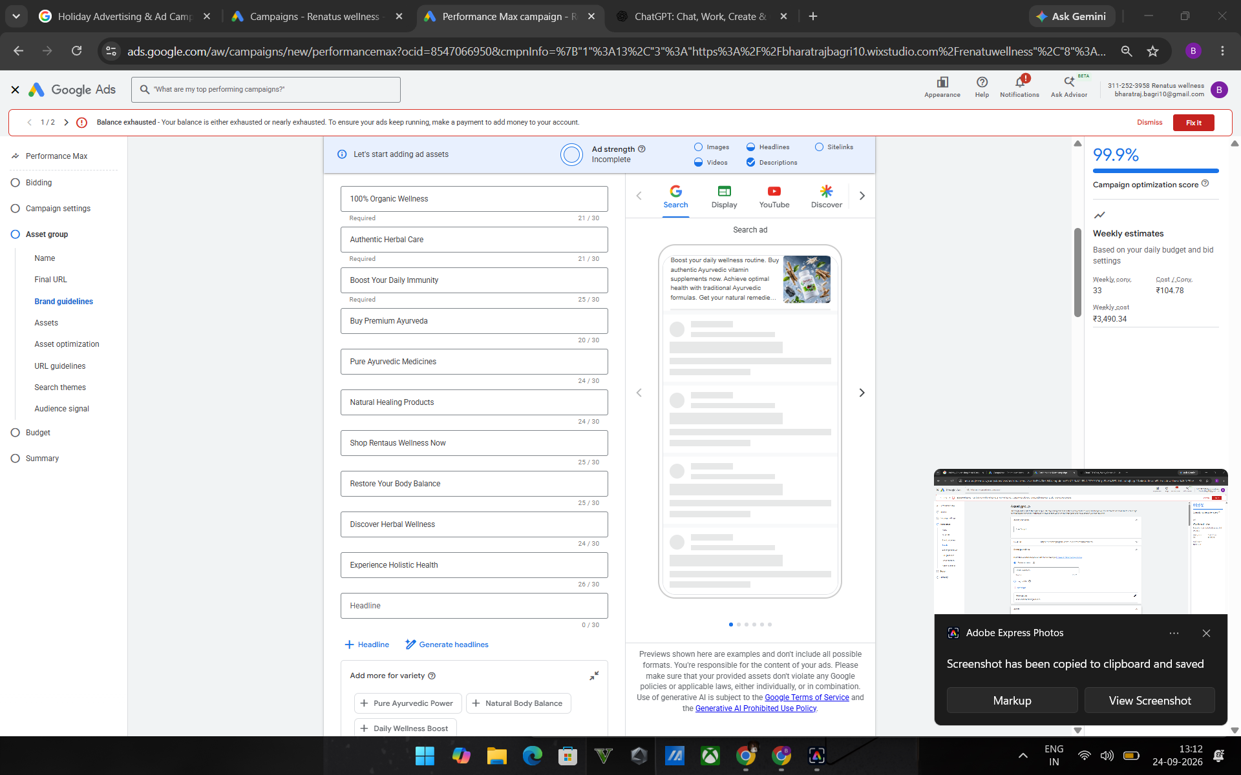
PERFORMANCE MAX ( Asset Group)

Slide 17
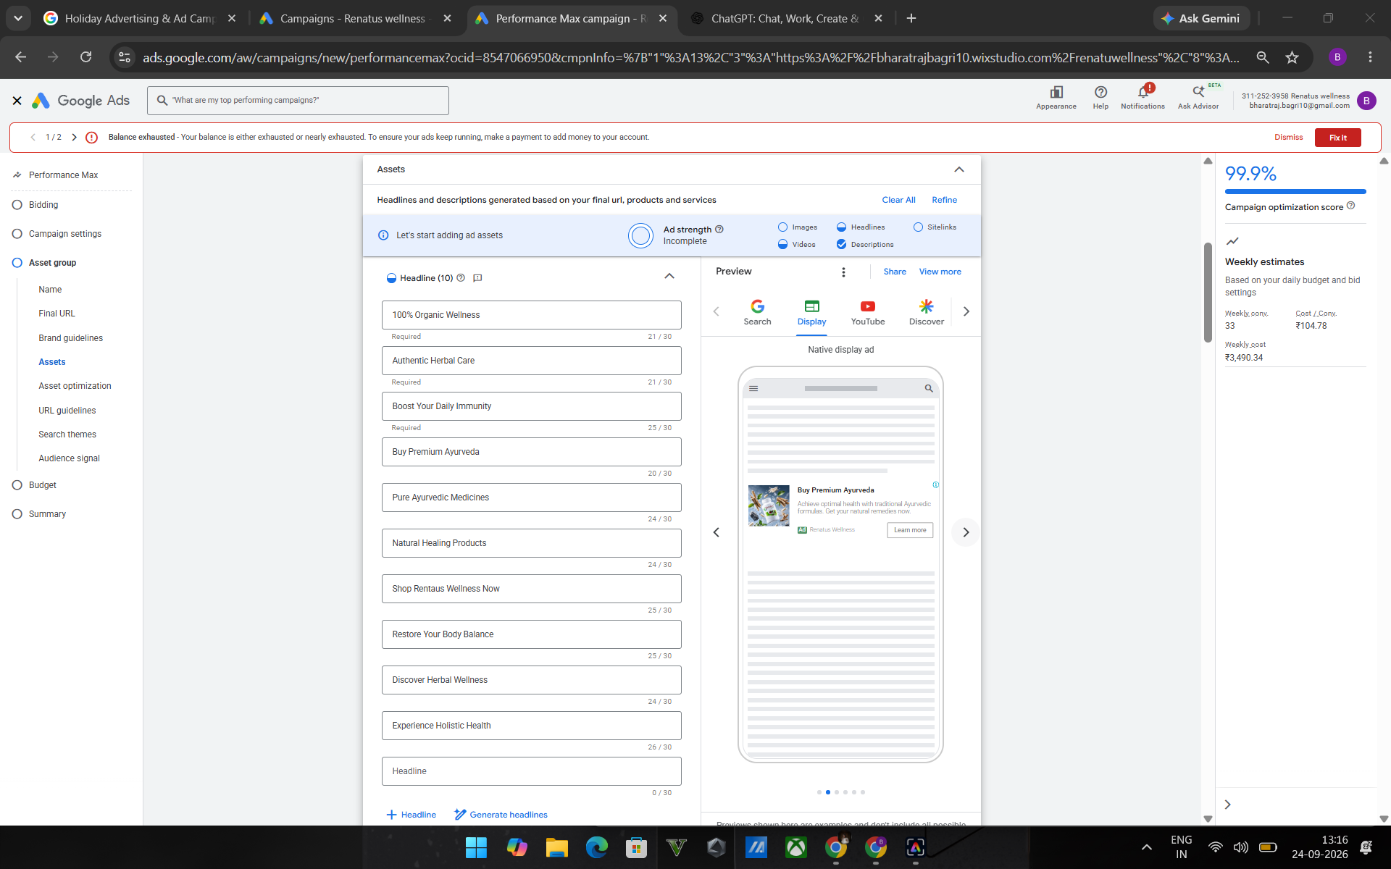
PERFORMANCE MAX ( Asset Group)

Slide 18
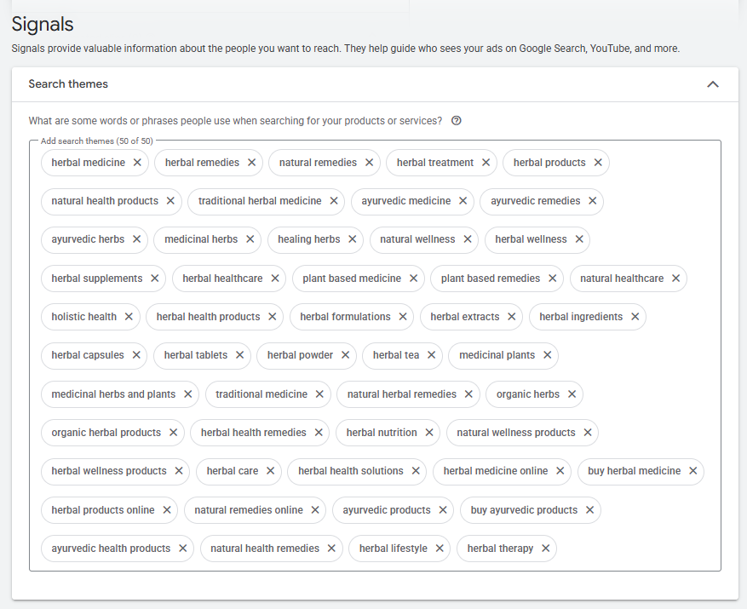
PERFORMANCE MAX ( Asset Group)

Slide 19
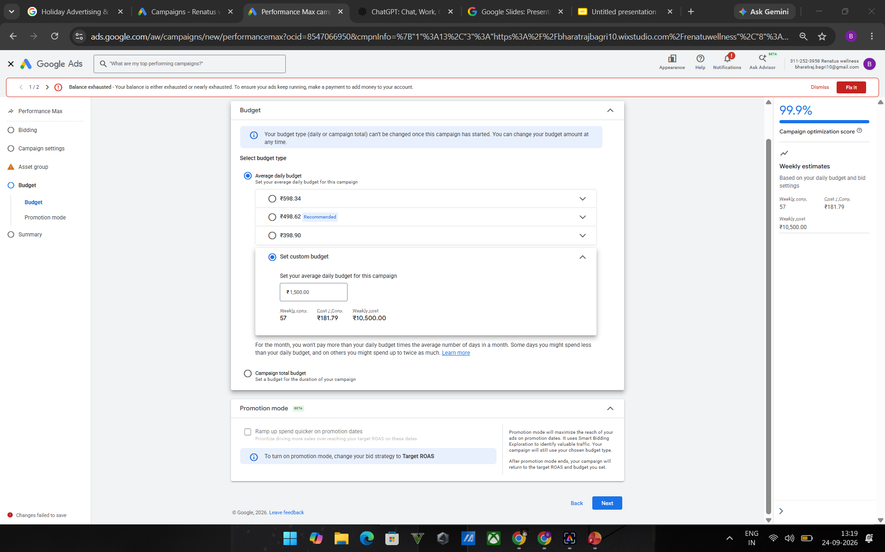
PERFORMANCE MAX ( Budget)

Slide 20
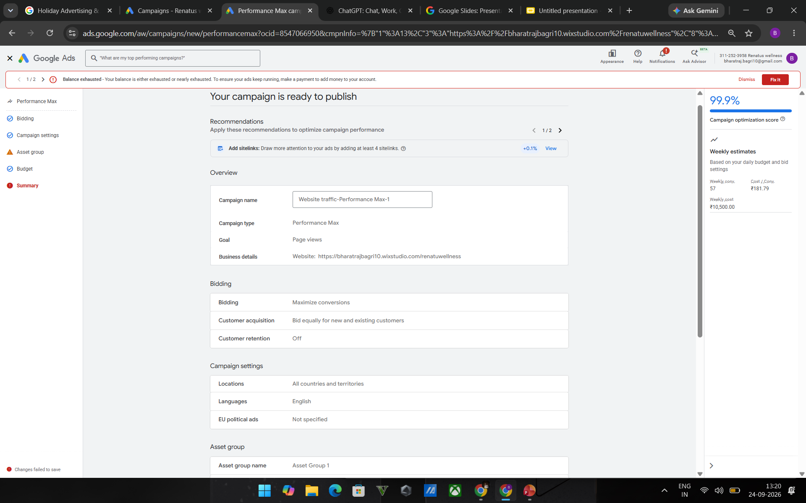
CAMPAIGN READY

Slide 21
CAMPAIGN READY

Slide 22
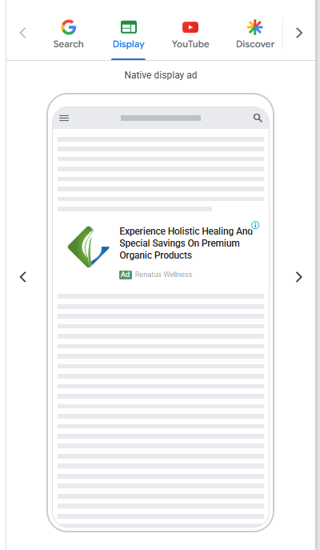
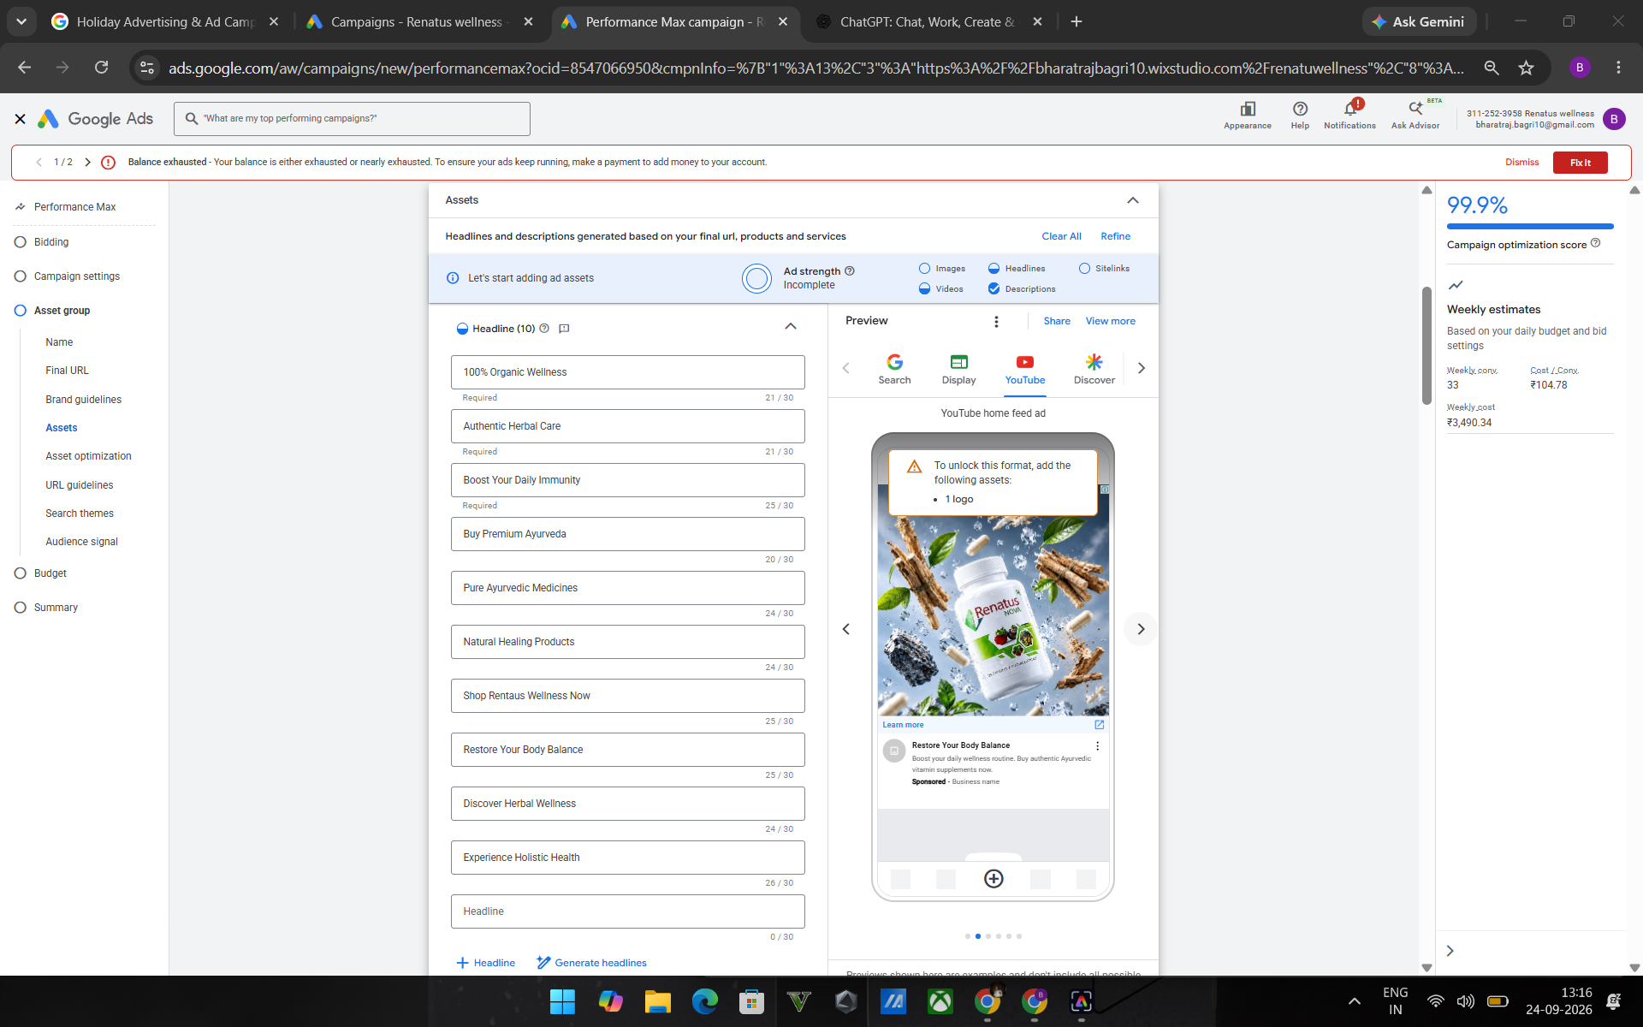
CAMPAIGN READY

Slide 23


